Slide 1
Building an OMT-Editor Using Design Patterns: An Experience Report and Sequence Diagram Animation
主講人:劉邦渝
時間:2003.03.24

Slide 2
Reference¹
Building an OMT-Editor Using Design Patterns: An Experience Report, Bart Wydaeghe…etc.
Technology of Object-Oriented Languages and Systems, August 03 - 07, 1998, Santa Barbara, California

Slide 3
Reference²
Evaluating Using Animation to Improve Understanding of Sequence Diagrams, Elizabeth Burd, Dawn Overy, Ady Wheetman.
Proceeding of 10th international Workshop on Program Comprehension (IWPC’02), 2002 Page(s): 107 -113

Slide 4
Outline
Introduction
Finding out patterns to use
Applying the patterns
Sequence diagram animation
Conclusion

Slide 5
INTRODUCTION

Slide 6
Introduction¹
Far too often we see the birth of new methodologies and theories without ever seeing papers that report about the results of actually trying them in practice.

Slide 7
Introduction²
Design patterns are a fairly new concept in current software engineering practice.
Using the book of GOF we start to build this editor while using the patterns in the book.

Slide 8
FINDING OUT PATTERNS TO USE

Slide 9
Finding out patterns to use¹
We learned that it is difficult to identify the design patterns we could use by just reading the Design Pattern book.
In general, we miss some kind of guideline that helps identifying the design patterns needed for a specific project.

Slide 10
Finding out patterns to use²
To solve this problem we came up with the idea of “application pattern sets”.
Such a set is based on one architectural pattern and describes how to use a set of other pattern.

Slide 11
What is application pattern set?
In our case we would have a MVC design pattern set consisting of the architectural pattern MVC, together with explanations on how to use patterns.
This would make the answer to the question: “How to know which patterns to use?”

Slide 12
Applying the patterns¹
The main structure of the application is defined by MVC.
We use Facade to couple the Model part with other applications.
We used the Visitor to save the model and generate java code.
Iterator is used throughout all our code.

Slide 13
Applying the patterns²
Finally we used the built-in Bridge pattern of Java AWT and Observer pattern to decouple the Model part and View-Control part of MVC.

Slide 14
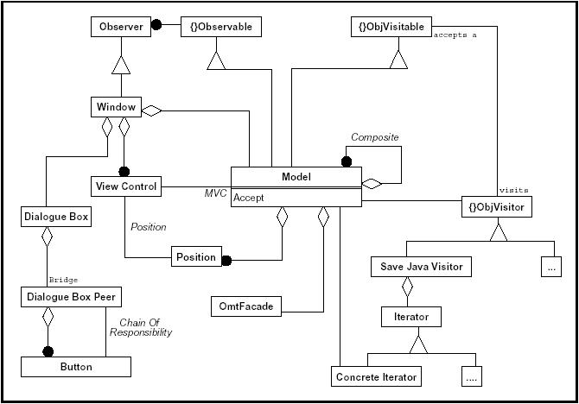
Overview of Design Patterns used

Slide 15
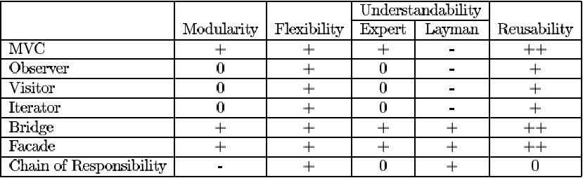
Evaluation of the Design Patterns

Slide 16
Evaluation of the Design Patterns
In general design patterns help a lot in explaining the design when the patterns have to be learned first. It is certainly worth effort to learn these patterns, because the time spent in learning them is easily recuperated afterwards.

Slide 17
ANIMATION SEQUENCE DIAGRAM

Slide 18
Animation for sequence diagram
Animation of a requirements diagram such as UML sequence diagram can aid stakeholders interpretation of the system and give them a greater understanding of the product proposed to be developed.

Slide 19
Main representation property
For sequence diagram, it is that of control flow. Therefore animation properties are best utilized though the animation of those aspects of the diagram that represent this flow of control.
It was decided to animate the process of messages passing between objects.

Slide 20
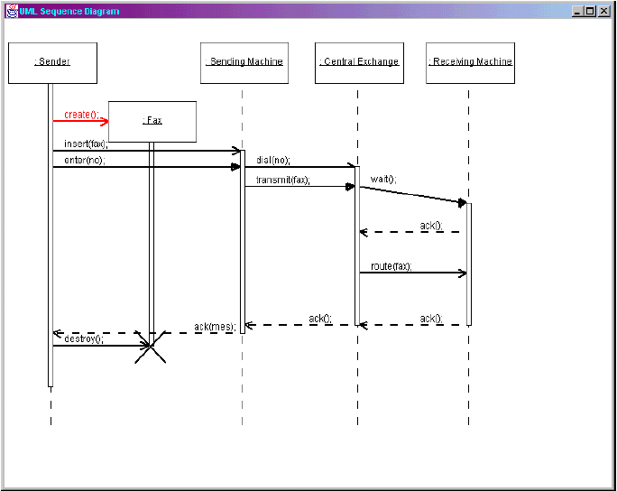
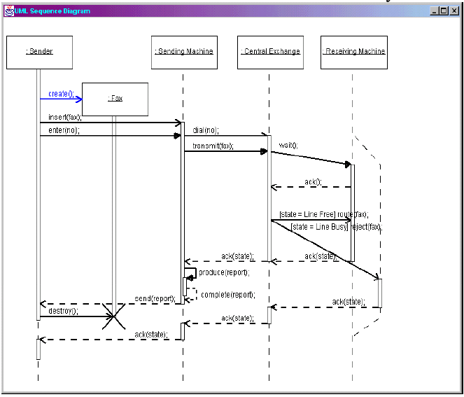

Slide 21
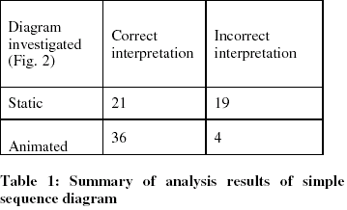
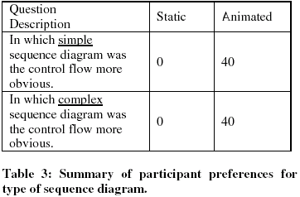
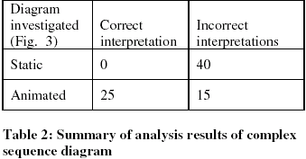
Analysis result

Slide 22
Conclusion
Design patterns offer a lot of advantages, as they make your design more flexible, more modular, more reusable and more understandable, but a lot of experience is needed to be able to apply these pattern to a specific application.
Animate diagram will help developer understand the system quickly and correctly.

